Slide 1
Rebooting Evaluation: From Tedious Exercise to Essential Change Agent
Toni Watt, Ph.D.
Professor of Sociology
Texas State University
San Marcos, Texas

Slide 2
Behavioral Health Affordable Care Act (BHACA) Initiative April 2014
NBHP
Network of Behavioral Health Providers

Slide 3
Objectives
To identify the key components of a strong outcomes-based evaluation
To develop a basic understanding of each step in the evaluation process
To identify the connection between rigorous evaluations and the mission of The Patient Protection and Affordable Care Act

Slide 4
Introduction
Dr. Toni Watt-Professor
Evaluation Research
Business/Advertising
Health
Mental and Physical Health
Child Health
Integrated Health Care (IHC) Evaluation
Adult and pediatric programs in Texas
Variety of IHC models and populations
Academic Research

Slide 6
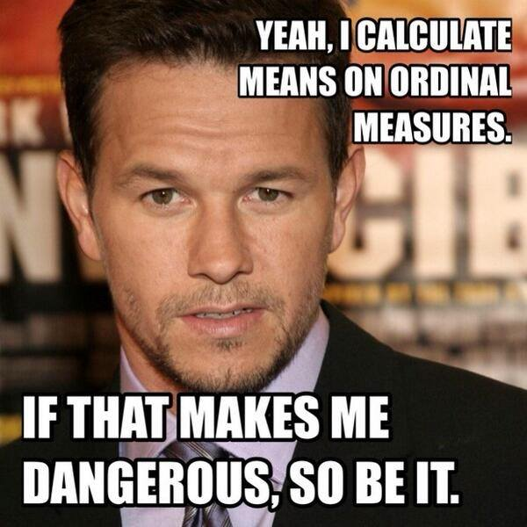
Inner research nerd or mark wahlberg picture

Slide 7
Why Evaluate?
Feedback Loop
Documentation
Dissemination
ACA Alignment

Slide 8
The Evaluation Process

Slide 9
Evaluation Planning- First Step
What are you trying to do?
Logic Model

Slide 10
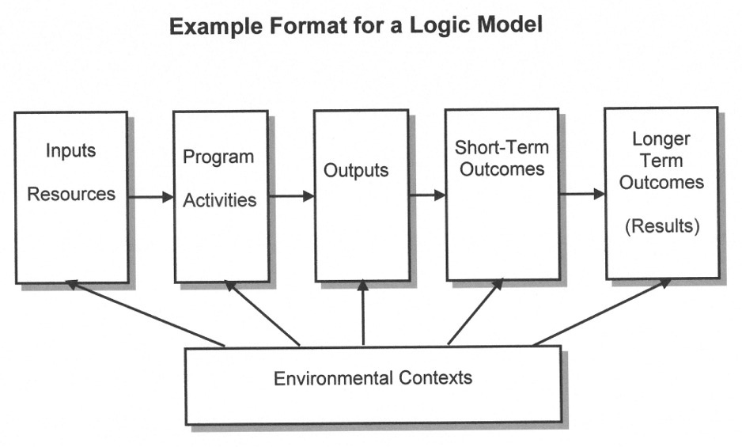

Slide 11
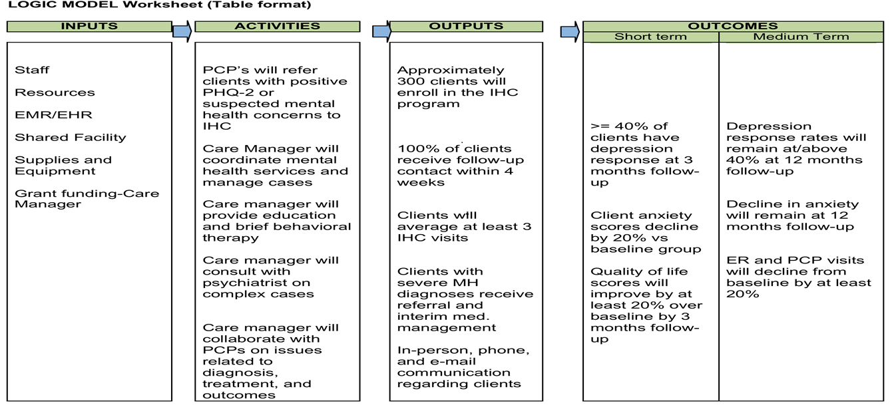
Example Logic Model: IHC Program

Slide 12
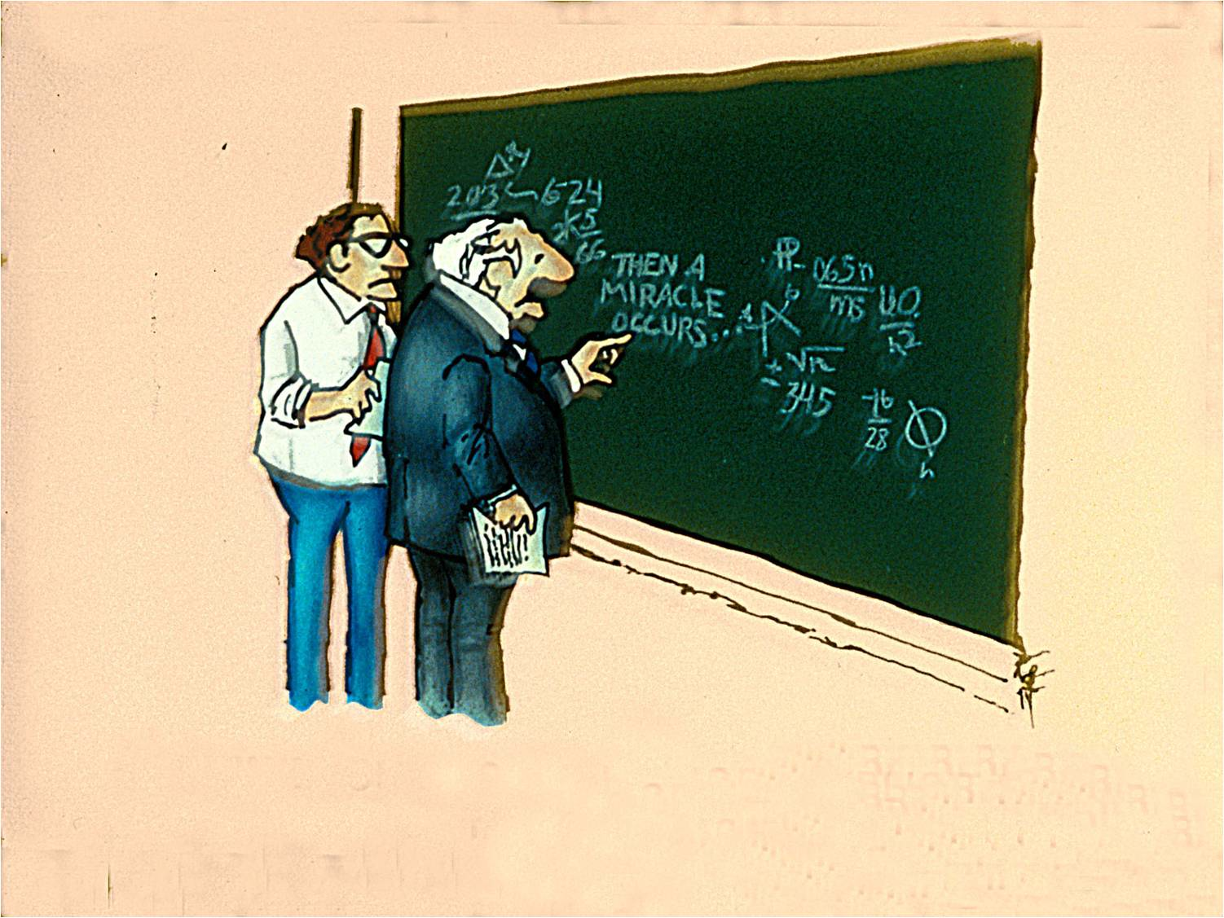

Slide 13
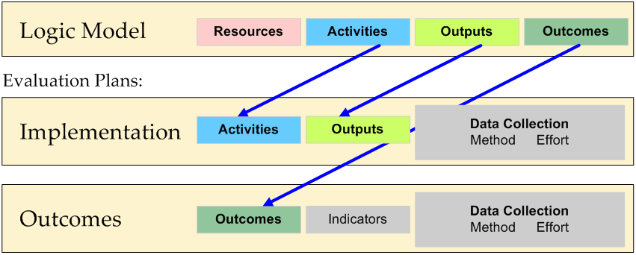
Evaluation Plan
Evaluation Plan Components
Goals/Objectives
Process (activities and outputs)
Outcomes
Evaluation Design
Metrics and Measuring Success

Slide 14
Evaluation Goals and Outcomes

Slide 15
Evaluation Goals and Objectives
Process
Goal: Offer mental health services to clients with depression and/or anxiety
Objective: Enroll 300 clients in the IHC program
Objective: Average 3+ contacts per client
Outcome
Goal: Improve client mental health
Objective: >= 40% of clients with depression experience depression response (50% reduction in symptoms) at three months

Slide 16
IHC: Processes and Outcomes Across 5 Sites in Texas
 | Site I | Site II | Site III | Site IV | Site V
Process # clients | 110 | 615 | 118 | 218 | 176
Process Average # contacts In-person Phone | 4.0 7.4 | 3.0 0.0 | 3.5 1.4 | 3.6 3.5 | 5.4 0.8
Outcomes % with 50% reduction PHQ-9 (3mths) -Usual care 29% -Goal =>40% | 61% | 42% | 79% | 54% | 59%

Slide 17
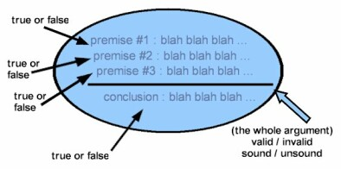
Evaluation Objectives
Unambiguous measure of success
Valid measure of success
Substantive improvement over no intervention
Subjective estimates
Estimates based on theory and/or data

Slide 18
Evaluation Objectives
Substantive improvement over no intervention
Outcome if no intervention?
What is substantive?

Slide 19
Evaluation Design

Slide 20
Experimental Design: Outcome Without The Intervention
Control group (True Experimental Design)
Random assignment to intervention and control (RCT)
Isolate the effect of the intervention and rule out alternative explanations
R O₁ X O₂
R O₁ O₂

Slide 21
Outcomes Without The Intervention
Quasi-Experimental Designs
Comparison group
Clients before intervention (baseline data), wait-list comparison group, or matched group
O₁ X O₂
O₁ O₂
Time series (client is own comparison)
(O₁ O₂ O₃ X O₄ O₅ O₆)

Slide 22
Outcomes Without The Intervention
Pre-experimental Designs
Pretest/Posttest (e.g. improve depression scores)
O₁ X O₂
One shot case study (e.g. majority of clients in remission after treatment)
X O₂

Slide 23
Patient depression scores declined by 30% with treatment

Slide 25
Outcomes Without The Intervention
Established guidelines/literature
Usual Care: 29% with depression respond to treatment
IHC Objective: >=40% with depression respond to treatment

Slide 26
Metrics and Measuring Success

Slide 27
How much improvement equals success?
Statistically significant
Real
Difficult with small samples
Substantive
Clinically meaningful
Effect size-Cohen’s d
Small effect (8%)
Medium effect (19%)
Large effect (29%)
Notes:
Effect sizes limited if not normal distribution. There are non parametric alternatives. Or you could have a nominal dichotomy as an outcome (depression response) and then use an odds ratio. Look for small, medium, or large increases in the odds.
Stats whisperer.com
Cohen used an example to be: small, is height of 15 and 16 year old girls in the US. Medium is large enough to be visible to the naked eye, 14 and 18 year old girls. And large is “grossly perceptible and therefore large” 13 and 18 year old girls.
Most interventions yield small effects relative to comparisons. Several IHC programs have achieved medium to large effects. So think about what you want to accomplish, what you think is clinically meaningful, and consider effect sizes as well.

Slide 28
Cohen’s d=Effect Size

Slide 29
Effect Size: Interpretation and Action
No change: Try again
Small effect: Examine
Medium effect: Stabilize
Large effect: Tell everyone!

Slide 30
Data
Data Sources
Care manager documentation
Client surveys
Medical records
Data Systems
Certified EMR/EHR
Web-based registry (University of Washington)
Data software (ETO, SPSS)
Excel

Slide 31
Measures
Considerations
Reliability and validity
Language
Ease of use
Cost
ACA Guidelines
Clinical Quality Measures
Person centered
Outcomes focused
Notes:
Train staff in how to use

Slide 32
Measures
Process Measures
# clients served
No-show rate
% screened for particular condition (depression, smoking)
% screened for tobacco use and if user, provided tobacco cessation information (CQM)
Average # mental health visits
% receiving follow-up
% children 6-12 dispensed medication for ADHD who had one follow-up visit with practitioner in 30 day initiation phase (CQM)
Medication compliance
Integration
Behavioral Health Integration Capacity Assessment (BHICA)
Notes:
Physical health measures, alcohol/substance abuse, social support,

Slide 33
Measures
Outcome Measures
Depression (adults)
PHQ-9, Beck (21 items), CES-D (20 items)
Anxiety (adults)
GAD (7 items)
Child/Adolescent mental health/development
PHQ-A (11-17), Vanderbilt (ADHD), Ages and Stages, BERS-2
Quality of life
Duke Health Profile (17 items), SF-12, employment, empowerment
Health (e.g. blood pressure, cholesterol, HbA1c, BMI)
Health behaviors (e.g. smoking, drinking, diet)
Primary care use
PCP visits, ER visits
SAMHSA-HRSA website (e.g. pain, trauma, drug/alcohol)
http://www.integration.samhsa.gov/clinical-practice/screening-tools

Slide 34
Measures: Other Considerations
Consumer Satisfaction/Experience
Identifying program strengths/limitations
Qualitative Methods
Subgroup Analysis (race/ethnicity, sex, primary language, disability status)
Unintended consequences

Slide 35
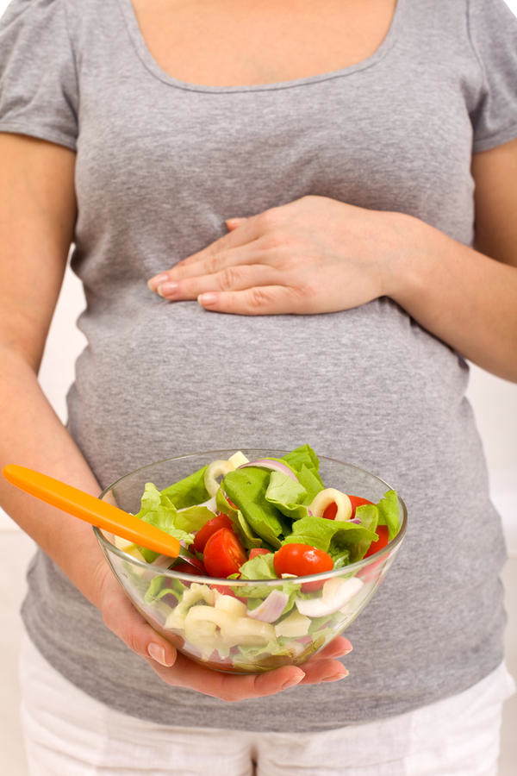

Slide 36
Analysis/Reporting
External
Expertise
Objectivity
Communication
Internal
Conflict of interest
Expertise
Shared goals
Response time

Slide 37
Analysis and Reporting
Create actionable report and process
Interpret
Distribute
Apply
What needs improvement?
What needs reinforcement?

Slide 38
Summary: #Isitover? #Whatdidshesay?

Slide 39
Evaluation
Document program goals
Turn goals into evaluation questions
Measure processes and outcomes
Really, measure outcomes
Start with 1-2 key measures for each
Gather baseline/comparison data pre/post
Gather intervention data pre/post
Compare difference in two groups
Small, medium, or large effect?
Share findings and use them

Slide 40
Create an Evaluation Culture
Commitment
Capacity
Change
“Success is inevitable. There is no such thing as failure, only feedback.”, Michael J. Gelb
“Other times, you're doing some piece of work and suddenly you get feedback that tells you that you have touched something that is very alive in the cosmos.” Leonard Nimoy

Slide 41
Triple Aim of the ACA
improving the patient experience of care
improving the health of the population
reducing the per capita cost of healthcare

Slide 42
Next Steps: Please Complete Evaluations and Feedback Forms

Slide 43
Thank You!

Slide 44
Toni Watt
(512) 245-3287
tw15@txstate.edu

